Slide 1
Regression Analysis
Lecture 3
Chapter 2: Regression Analysis and Time Series Analysis
Institute of Engineering
Asst. Prof. Anita Prajapati, Ph.D.
7 June 2023

Slide 2
Spreadsheet Modeling & Decision Analysis: Chapter 9 : Regression Analysis
A Practical Introduction to Management Science, 3e
by Cliff Ragsdale

Slide 3
Introduction to Regression Analysis (RA)
Regression Analysis is used to estimate a function f( ) that describes the relationship between a continuous dependent variable and one or more independent variables.
Y = f(X₁, X₂, X₃,…, X_{n}) + ε
Note:
f( ) describes systematic variation in the relationship.
ε represents the unsystematic variation (or random error) in the relationship.

Slide 4
An Example
Consider the relationship between advertising (X₁) and sales (Y) for a company.
There probably is a relationship...
...as advertising increases, sales should increase.
But how would we measure and quantify this relationship?
See file Fig 9-1.xls

Slide 5
A Scatter Plot of the Data
Notes:
Level of advertising is subject to random fluctuation
Some of the variations in sales is not accounted for by advertising

Slide 6
The Nature of a Statistical Relationship
Y
Regression Curve
Probability distributions for Y at different levels of X
X
Notes:
Unsystematic error, error tends to zero if the distribution in normally distributed (higher or lower so neutralizes)

Slide 7
A Simple Linear Regression Model
The scatter plot shows a linear relation between advertising and sales.
So the following regression model is suggested by the data,
This refers to the true relationship between the entire population of advertising and sales values.
The estimated regression function (based on our sample) will be represented as,

Slide 8
Determining the Best Fit
Numerical values must be assigned to b₀ and b₁
The method of “least squares” selects the values that minimize:
If ESS=0 our estimated function fits the data perfectly.
We could solve this problem using Solver...

Slide 9
Using Solver...
See file Fig9-4.xls

Slide 10
The Estimated Regression Function
The estimated regression function is:

Slide 11
Using the Regression Tool
Excel also has a built-in tool for performing regression that:
is easier to use
provides a lot more information about the problem
See file Fig9-1.xls

Slide 12
The TREND() Function
TREND(Y-range, X-range, X-value for prediction)
where:
Y-range is the spreadsheet range containing the dependent Y variable,
X-range is the spreadsheet range containing the independent X variable(s),
X-value for prediction is a cell (or cells) containing the values for the independent X variable(s) for which we want an estimated value of Y.
Note: The TREND( ) function is dynamically updated whenever any inputs to the function change. However, it does not provide the statistical information provided by the regression tool. It is best to use these two different approaches to doing regression in conjunction with one another.

Slide 13
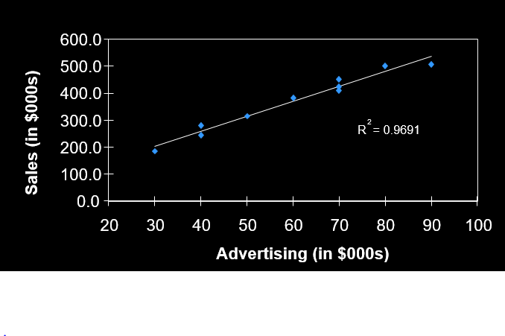
Evaluating the “Fit”

Slide 14
The R² Statistic
The R² statistic indicates how well an estimated regression function fits the data.
0<= R² <=1
It measures the proportion of the total variation in Y around its mean that is accounted for by the estimated regression equation.
To understand this better, consider the following graph...

Slide 15
Error Decomposition
Y_{i} (actual value)
{
Y
*
}
^
Y_{i} -
Y_{i}
Y_{i} -
^
Y
Y_{i} (estimated value)
}
^
Y_{i} - Y
Y
^
Y = b₀ + b₁X
X

Slide 16
Partition of the Total Sum of Squares
or,
TSS = ESS + RSS

Slide 17
Making Predictions
Suppose we want to estimate the average levels of sales expected if $65,000 is spent on advertising.
Estimated Sales = 36.342 + 5.550 * 65
= 397.092
So when $65,000 is spent on advertising, we expect the average sales level to be $397,092

Slide 18
The Standard Error
The standard error measures the scatter in the actual data around the estimate regression line.
where k = the number of independent variables
For our example, S_{e} = 20.421
This is helpful in making predictions...

Slide 19
An Approximate Prediction Interval
An approximate 95% prediction interval for a new value of Y when X₁=X_{1h} is given by
where:
Example: If $65,000 is spent on advertising:
95% lower prediction interval = 397.092 - 2*20.421 = 356.250
95% upper prediction interval = 397.092 + 2*20.421 = 437.934
If we spend $65,000 on advertising we are approximately 95% confident actual sales will be between $356,250 and $437,934.

Slide 20
An Exact Prediction Interval
A (1-α)% prediction interval for a new value of Y when X₁=X_{1h} is given by
where

Slide 21
Example
If $65,000 is spent on advertising:
95% lower prediction interval = 397.092 - 2.306*21.489 = 347.556
95% upper prediction interval = 397.092 + 2.306*21.489 = 446.666
If we spend $65,000 on advertising we are 95% confident actual sales will be between $347,556 and $446,666.
This interval is only about $20,000 wider than the approximate one calculated earlier but was much more difficult to create.
The greater accuracy is not always worth the trouble.

Slide 22
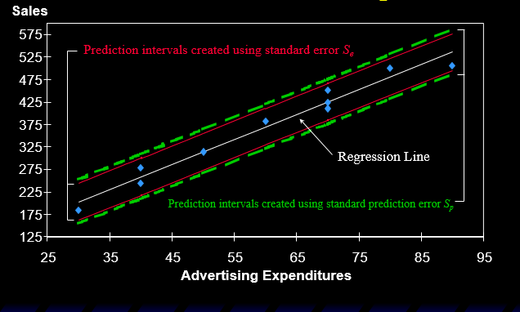
Comparison of Prediction Interval Techniques

Slide 23
Confidence Intervals for the Mean
A (1-α)% confidence interval for the true mean value of Y when X₁=X_{1h} is given by
where:

Slide 24
A Note About Extrapolation
Predictions made using an estimated regression function may have little or no validity for values of the independent variables that are substantially different from those represented in the sample.

Slide 25
Regression Analysis (cont…)
Lecture 4
Chapter 2: Regression Analysis and Time Series Analysis
Institute of Engineering
Asst. Prof. Anita Prajapati, Ph.D.
9 June 2023

Slide 26
Multiple Regression Analysis
Most regression problems involve more than one independent variable
If each independent variables varies in a linear manner with Y, the estimated regression function in this case is:
The optimal values for the b_{i} can again be found by minimizing the ESS.
The resulting function fits a hyperplane to our sample data.

Slide 27
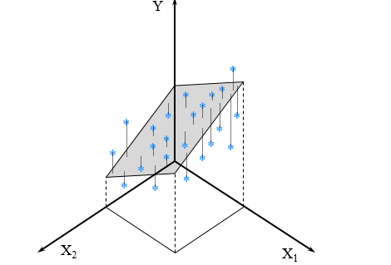
Example Regression Surface for Two Independent Variables

Slide 28
Multiple Regression Example: Real Estate Appraisal
A real estate appraiser wants to develop a model to help predict the fair market values of residential properties.
Three independent variables will be used to estimate the selling price of a house:
total square footage
number of bedrooms
size of the garage
See data in file Fig9-17.xls

Slide 29
Selecting the Model
We want to identify the simplest model that adequately accounts for the systematic variation in the Y variable.
Arbitrarily using all the independent variables may result in overfitting.
A sample reflects characteristics:
representative of the population
specific to the sample
We want to avoid fitting sample specific characteristics -- or overfitting the data.

Slide 30
Models with One Independent Variable
With simplicity in mind, suppose we fit three simple linear regression functions:
The model using X₁ accounts for 87% of the variation in Y, leaving 13% unaccounted for.
Key regression results are:
Variables Adjusted Parameter
in the Model R² R² S_{e} Estimates
X₁ 0.870 0.855 10.299 b₀=9.503, b₁=56.394
X₂ 0.759 0.731 14.030 b₀=78.290, b₂=28.382
X₃ 0.793 0.770 12.982 b₀=16.250, b₃=27.607

Slide 31
Important Software Note
When using more than one independent variable, all variables for the X-range must be in one continuous block of cells (that is, in adjacent columns).

Slide 32
Models with Two Independent Variables
Now suppose we fit the following models with two independent variables:
The model using X₁ and X₂ accounts for 93.9% of the variation in Y, leaving 6.1% unaccounted for.
Key regression results are:
Variables Adjusted Parameter
in the Model R² R² S_{e} Estimates
X₁ 0.870 0.855 10.299 b₀=9.503, b₁=56.394
X₁ & X₂ 0.939 0.924 7.471 b₀=27.684, b₁=38.576 b₂=12.875
X₁ & X₃ 0.877 0.847 10.609 b₀=8.311, b₁=44.313 b₃=6.743

Slide 33
The Adjusted R² Statistic
As additional independent variables are added to a model:
The R² statistic can only increase.
The Adjusted-R² statistic can increase or decrease.
The R² statistic can be artificially inflated by adding any independent variable to the model.
We can compare adjusted-R² values as a heuristic to tell whether adding an additional independent variable really helps to improve a regression model.

Slide 34
A Comment On Multicollinearity
It should not be surprising that adding X₃ (# of bedrooms) to the model with X₁ (total square footage) did not significantly improve the model.
Both variables represent the same (or very similar) things -- the size of the house.
These variables are highly correlated (or collinear).
Multicollinearity should be avoided.

Slide 35
Model with Three Independent Variables
Now suppose we fit the following model with three independent variables:
The model using X₁ and X₂ appears to be best:
Highest adjusted-R²
Lowest S_{e} (most precise prediction intervals)
Key regression results are:
Variables Adjusted Parameter
in the Model R² R² S_{e} Estimates
X₁ 0.870 0.855 10.299 b₀=9.503, b₁=56.394
X₁ & X₂ 0.939 0.924 7.471 b₀=27.684, b₁=38.576, b₂=12.875
X_{1,} X₂ & X₃ 0.943 0.918 7.762 b₀=26.440, b₁=30.803, b₂=12.567, b₃=4.576

Slide 36
Making Predictions
Let’s estimate the average selling price of a house with 2,100 square feet and a 2-car garage:
The estimated average selling price is $134,444
A 95% prediction interval for the actual selling price is approximately:
95% lower prediction interval = 134.444 - 2*7.471 = $119,502
95% lower prediction interval = 134.444 + 2*7.471 = $149,386

Slide 37
Binary Independent Variables
Other types of non-quantitative factors could independent variables could be included in the analysis using binary variables.
Example: The presence (or absence) of a swimming pool,
Example: Whether the roof is in good, average or poor condition,

Slide 38
Polynomial Regression
This graph suggests a quadratic relationship between square footage (X) and selling price (Y).

Slide 39
The Regression Model
An appropriate regression function in this case might be,
or equivalently,
where,

Slide 40
Implementing the Model
See file Fig9-25.xls

Slide 41
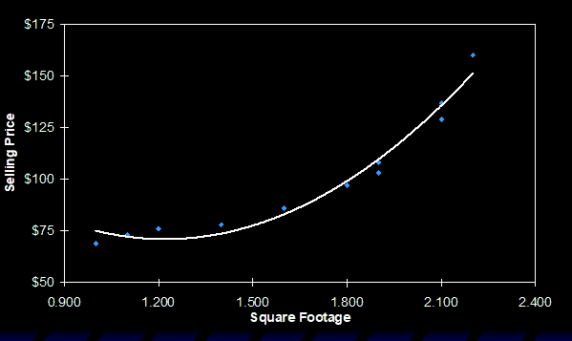
Graph of Estimated Quadratic Regression Function

Slide 42
Fitting a Third Order Polynomial Model
We could also fit a third order polynomial model,
or equivalently,
where,

Slide 43
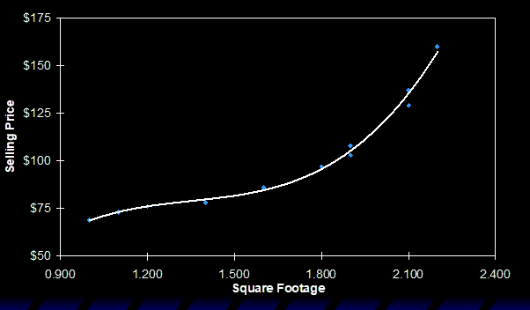
Graph of Estimated Third Order Polynomial Regression Function

Slide 44
Overfitting
When fitting polynomial models, care must be taken to avoid overfitting.
The adjusted-R² statistic can be used for this purpose here also.

Slide 45
Assignments
Chapter 9
Question no: 6,8,9,10,12,13,15,17,20

Slide 46
THANK YOU!!!

